Slide 1
Mobile Phone Price Prediction
Feature Extraction & Machine Learning Report
Ayan kumar shaw

Slide 2
Project Overview
Objective: Predict mobile phone prices using key features
Importance: Helps optimize pricing and marketing strategies
Dataset: 285+ phones with specs and prices

Slide 3
Data Exploration
Columns: Model, Color, Memory, RAM, Battery, Cameras, AI Lens, Height, Processor, Price
Data types: Mix of categorical and numerical
Range of prices: ₹1,000 – ₹49,999

Slide 4
Data Preprocessing
Handled missing values and outliers
Encoded categorical variables (One‑Hot Encoding)
Normalized numeric features for model stability

Slide 5
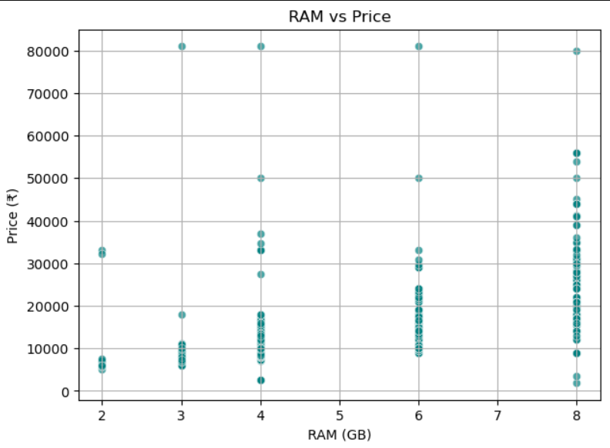
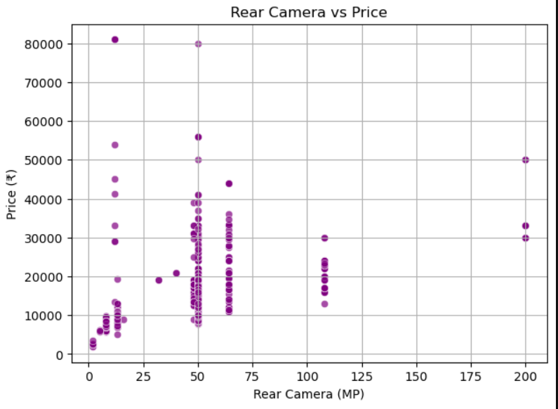
Correlation Heatmap (Visualization)

Slide 6
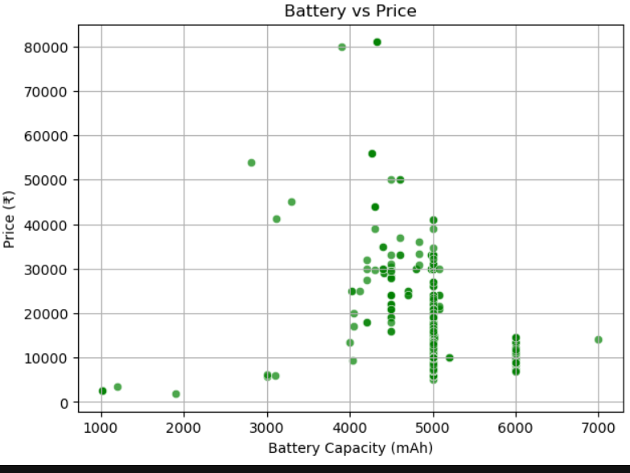
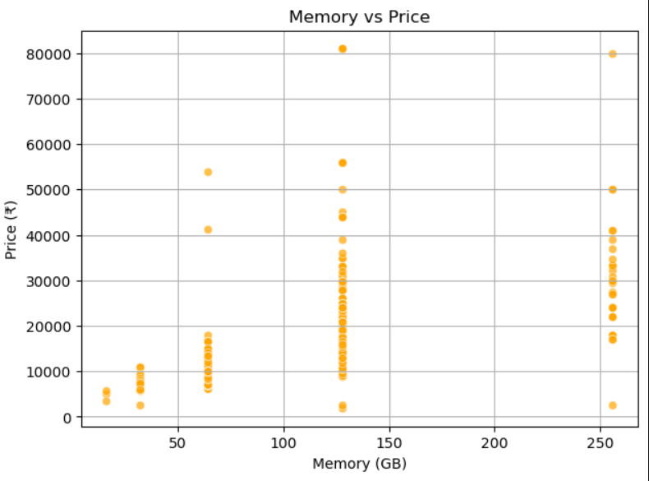
Battery vs price and Memory vs Price

Slide 7
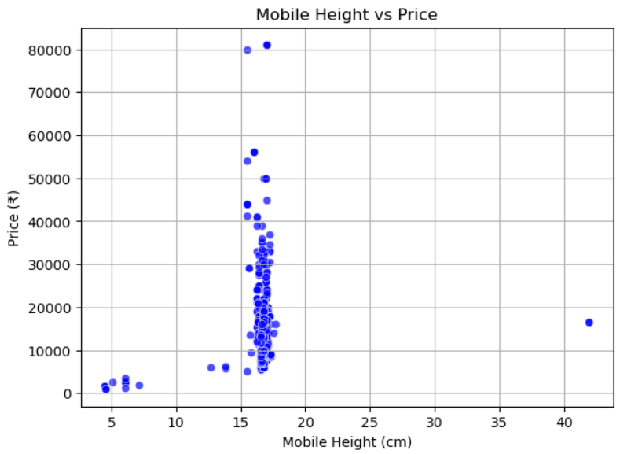
Mobile Height vs price

Slide 8
Feature Importance (Model‑based)
RAM
Processor type
Rear camera megapixels
Memory capacity
Battery capacity (moderate impact)

Slide 9
Model Building
Algorithms tested:
Linear Regression
Decision Tree
Random Forest
Gradient Boosting
Split: 80% training, 20% testing

Slide 10
Model Building
Algorithms tested:
Linear Regression
Decision Tree
Random Forest
Gradient Boosting
Split: 80% training, 20% testing

Slide 11
Model Evaluation
Metrics used:
Mean Absolute Error (MAE)
Root Mean Squared Error (RMSE)
Random Forest performed best (lowest RMSE)

Slide 12
Recommendations
Focus marketing on RAM, Processor, and Camera specs
Offer price tiers based on these premium features
Optimize mid‑range models with balanced specs
Tools & Libraries
Python, Pandas, NumPy, Matplotlib, Seaborn
Scikit‑learn for model building and evaluation

Slide 13
Conclusion
Predictive model accurately estimates mobile prices
Key drivers: RAM, Processor, Camera
Supports data‑driven pricing strategy

